Slide 1


Model Evaluation and Selection
14
PART III · MACHINE LEARNING CORE
CHAPTER 14 · WEEK 8
Data Science — From Foundations to Intelligent Systems
LECTURER
Dr. Mustafa Hameed
THE ISLAMIA UNIVERSITY OF BAHAWALPUR
Bahawalpur, Pakistan
Department of Information Technology · BSIT · Fall 2026
Notes:
Chapter 14: Model Evaluation and Selection. Part 3 — Machine Learning Core. Week 8: Classification; evaluation (revision). Handout pages 88–94.

Slide 2

Where this chapter sits
THE COURSE
PART I
PART II
PART III
PART IV
PART V
PART VI
1
2
3
4
5
6
7
8
9
10
11
12
13
14
15
16
17
18
19
20
21
22
23
24
25
26
27
28
29
30
31
32
Model Evaluation and Selection
BUILDS ON
USED LATER IN
Ch 6 Probability and Uncertainty
Ch 15 Feature Engineering and Ensembles
Ch 11 Machine Learning Fundamentals
Ch 16 Unsupervised Learning and Anomaly Detection
Ch 13 Supervised Learning II: Classification
Ch 19 Sequences, Time Series and Streaming Analytics
Ch 26 Data Science for Cybersecurity
Ch 27 MLOps: Deployment, Monitoring and Reliability
Data Science · Chapter 14 · Model Evaluation and Selection
Handout p. 88 2
Notes:
Place the chapter. Before you start: Chapter 6 (the base-rate arithmetic — precision is the posterior computed there), Chapter 11 (splits) and Chapter 13 (thresholds). Revision note: revises Machine Learning Fall 2026, Chapter 8 (Measuring Classifier Performance).

Slide 3

What you will be able to do
LEARNING OUTCOMES
By the end of this chapter you will be able to:
1
Build a confusion matrix and derive accuracy, precision, recall, specificity and F₁ from it.
2
Explain why accuracy is misleading under class imbalance, and choose an appropriate metric instead.
3
Read an ROC curve and a precision–recall curve, and say which to use when.
4
Select a decision threshold from the costs of the two error types.
5
Apply k-fold cross-validation and explain why it beats a single split.
Data Science · Chapter 14 · Model Evaluation and Selection
Handout p. 88 3
Notes:
Read these out: they are the chapter's contract with the room. Each click adds one.

Slide 4

Vocabulary for this chapter
KEY TERMS
confusion matrix
true/false positive and negative
accuracy
precision
recall (sensitivity)
specificity
F1 score
ROC curve
AUC
precision–recall curve
class imbalance
threshold tuning
k-fold cross-validation
stratification
Each term is defined where it first matters — not here.
Data Science · Chapter 14 · Model Evaluation and Selection
Handout p. 88 4
Notes:
Do not define these now; they arrive one at a time. This slide is for the students' notes. Terms: confusion matrix; true/false positive and negative; accuracy; precision; recall (sensitivity); specificity; F1 score; ROC curve; AUC; precision–recall curve; class imbalance; threshold tuning; k-fold cross-validation; stratification.

Slide 5
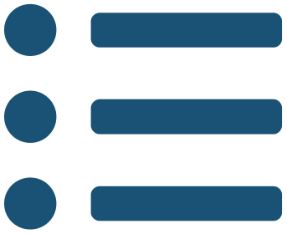
In this chapter
IN THIS CHAPTER
14.1
Why This Chapter Is the Hinge of Part III
p. 88 ›
14.2
The Confusion Matrix
p. 88 ›
14.3
Trading Precision Against Recall
p. 89 ›
14.4
Choosing the Threshold from Costs
p. 90 ›
14.5
Cross-Validation
p. 91 ›
Data Science · Chapter 14 · Model Evaluation and Selection
Handout pp. 88–94 5
Notes:
The route through the chapter. Each row is a link: click it to jump to that section in the slide show.

Slide 6

Why This Chapter Is the Hinge of Part III
KEY IDEA
You cannot improve what you cannot measure, and you cannot choose between the models of Chapter 13 without a number that reflects what you actually care about. Every remaining chapter of this book assumes you can evaluate honestly. Most published failures of applied machine learning are failures of evaluation, not of algorithms.
Data Science · Chapter 14 · Model Evaluation and Selection
§14.1 · Handout p. 88 6
Notes:
Say this in your own words first; the slide is the handout's wording.

Slide 7
The Confusion Matrix
SECTION 2 OF 5
14.2
14.1 Why This Chapter Is the Hinge of Part III
14.2 The Confusion Matrix
14.3 Trading Precision Against Recall
14.4 Choosing the Threshold from Costs
14.5 Cross-Validation
Data Science · Chapter 14
Handout §14.2 7
Notes:
Pause. Name the question this section answers.

Slide 8

Confusion Matrix
DEFINITION
A table cross-tabulating predictions against truth. For two classes it has four cells: true positives (TP), false positives (FP), false negatives (FN) and true negatives (TN). Every classification metric is some ratio of these four numbers.
Data Science · Chapter 14 · Model Evaluation and Selection
§14.2 · Handout p. 88 8
Notes:
Read the box aloud, then ask for an example from the room before moving on.

Slide 9
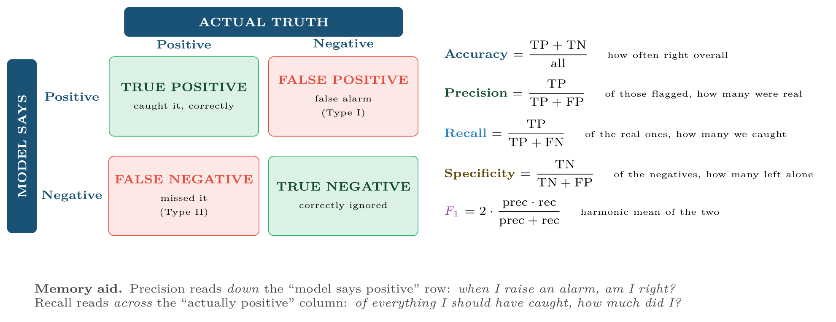
The confusion matrix and the five metrics derived from it
FIGURE 14.1
Learn which cells each metric uses; every question in this chapter reduces to that.
Data Science · Chapter 14 · Model Evaluation and Selection
§14.2 · Handout p. 88 9
Notes:
Figure 14.1 (handout p. 89): The confusion matrix and the five metrics derived from it. Learn which cells each metric uses; every question in this chapter reduces to that.

Slide 10

The Same Model, Five Metrics
WORKED EXAMPLE
An intrusion detector is run on 10,000 sessions, of which 100 are genuine attacks. It flags 190 sessions, of which 80 are real attacks.
Fill in the four cells:
• TP = 80 (flagged and real)
• FP = 190 − 80 = 110 (flagged, not real)
• FN = 100 − 80 = 20 (real, not flagged)
• TN = 10,000 − 80 − 110 − 20 = 9,790
Data Science · Chapter 14 · Model Evaluation and Selection
§14.2 · Handout p. 88 10
Notes:
Each click adds one step of the working. Ask for the next number before you reveal it.

Slide 11
The Same Model, Five Metrics (continued)
WORKED EXAMPLE
The headline number is the useless one. 98.7% accuracy sounds superb — but a model that flags nothing at all scores 99.0% here, beating it. Accuracy is dominated by the 9,900 easy negatives.
The informative pair is precision 42% and recall 80%: we catch four attacks in five, and roughly three in five alarms are wasted analyst time. Whether that is acceptable is the expected-value question of Chapter 6, and it is the only version of the result worth reporting.
Data Science · Chapter 14 · Model Evaluation and Selection
§14.2 · Handout p. 88 11
Notes:
Each click adds one step of the working. Ask for the next number before you reveal it.

Slide 12

The Accuracy Paradox
WATCH OUT
When one class is rare, always compute the majority-class baseline first. If 99% of traffic is benign, “predict benign” scores 99%. Any accuracy figure below that is worse than doing nothing, and any figure just above it may be worthless. Report precision and recall, or a metric built from them.
Data Science · Chapter 14 · Model Evaluation and Selection
§14.2 · Handout p. 88 12
Notes:
Read the box aloud, then ask for an example from the room before moving on.

Slide 13
Trading Precision Against Recall
SECTION 3 OF 5
14.3
14.1 Why This Chapter Is the Hinge of Part III
14.2 The Confusion Matrix
14.3 Trading Precision Against Recall
14.4 Choosing the Threshold from Costs
14.5 Cross-Validation
Data Science · Chapter 14
Handout §14.3 13
Notes:
Pause. Name the question this section answers.

Slide 14

They Move in Opposite Directions
CONCEPT
Lower the threshold: you flag more things, so recall rises and precision falls. Raise it: precision rises and recall falls. You cannot maximise both, so you must decide which error is more expensive — and that is a domain decision, made with the stakeholder.
Data Science · Chapter 14 · Model Evaluation and Selection
§14.3 · Handout p. 89 14
Notes:
Read the box aloud, then ask for an example from the room before moving on.

Slide 15
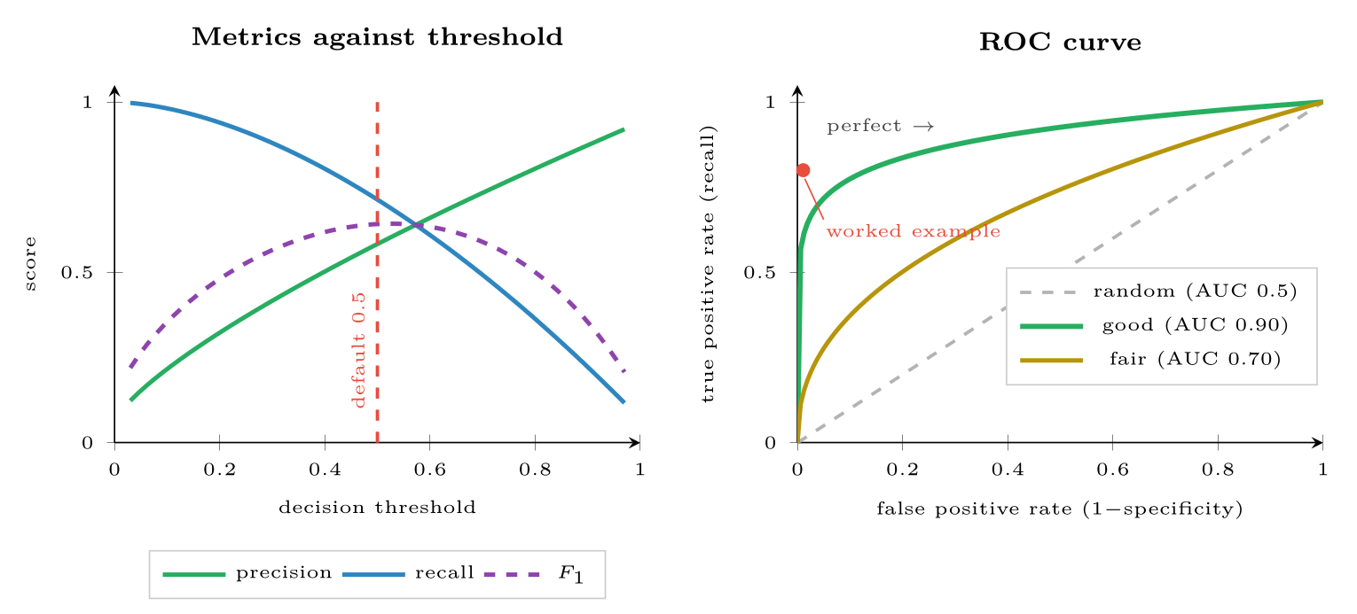
Trading Precision Against Recall
FIGURE 14.2
Left: every metric depends on the threshold, so quoting one without the threshold is incomplete. Right: the ROC curve sweeps all thresholds at once; AUC is the area beneath it.
Data Science · Chapter 14 · Model Evaluation and Selection
§14.3 · Handout p. 89 15
Notes:
Figure 14.2 (handout p. 90): Left: every metric depends on the threshold, so quoting one without the threshold is incomplete. Right: the ROC curve sweeps all thresholds at once; AUC is the area beneath it.

Slide 16
ROC, AUC and the PR Curve
DEFINITION
The ROC curve plots recall against false-positive rate across all thresholds. AUC is the area under it: the probability that the model ranks a random positive above a random negative. 0.5 is chance, 1.0 is perfect.
The precision–recall curve plots precision against recall instead.
Data Science · Chapter 14 · Model Evaluation and Selection
§14.3 · Handout p. 89 16
Notes:
Read the box aloud, then ask for an example from the room before moving on.

Slide 17
Use PR, Not ROC, When Positives Are Rare
WATCH OUT
ROC’s x-axis is the false-positive rate — FP divided by the huge number of negatives. With 9,900 negatives, 110 false positives is a rate of 0.011, which looks negligible on an ROC plot even though it means 58% of your alerts are wrong. ROC curves flatter rare-event detectors badly. The PR curve, which uses precision directly, does not. In cybersecurity, fraud and predictive maintenance, report the PR curve.
Data Science · Chapter 14 · Model Evaluation and Selection
§14.3 · Handout p. 89 17
Notes:
Read the box aloud, then ask for an example from the room before moving on.

Slide 18
Setting a Threshold with Money
WORKED EXAMPLE
A dropout-prediction model is to drive outreach calls.
• Cost of a false positive: one wasted 20-minute call ≈ $15.
• Cost of a false negative: a student lost, worth ≈ $4,000 in fees and outcomes.
The ratio is roughly 1:267 — a miss is 267 times more costly than a false alarm.
Consequence. You should accept a great many false alarms to avoid one miss. Optimise recall subject to a staffing limit, not F₁ (which weights precision and recall equally and would be the wrong objective here).
Total expected cost at threshold t:
Evaluate on the validation set across a grid of t and pick the minimum.
Data Science · Chapter 14 · Model Evaluation and Selection
§14.4 · Handout p. 90 18
Notes:
Each click adds one step of the working. Ask for the next number before you reveal it.

Slide 19
Setting a Threshold with Money (continued)
WORKED EXAMPLE
Threshold | FP | FN | Cost
0.05 | 780 | 2 | $19,700 | ← minimum
0.10 | 420 | 4 | $22,300
0.20 | 210 | 9 | $39,150
0.30 | 120 | 16 | $65,800
0.50 | 48 | 31 | $124,720 | the default
The optimum is 0.05, not 0.5 — a threshold that flags roughly a third of the cohort. That is only workable if staff can handle the volume, which is why the real constraint is usually written as “maximise recall subject to flagging at most 20% of students”. Either way, the default threshold was ten times too high and cost six times more.
Data Science · Chapter 14 · Model Evaluation and Selection
§14.4 · Handout p. 90 19
Notes:
Each click adds one step of the working. Ask for the next number before you reveal it.

Slide 20
Cross-Validation
SECTION 5 OF 5
14.5
14.1 Why This Chapter Is the Hinge of Part III
14.2 The Confusion Matrix
14.3 Trading Precision Against Recall
14.4 Choosing the Threshold from Costs
14.5 Cross-Validation
Data Science · Chapter 14
Handout §14.5 20
Notes:
Pause. Name the question this section answers.

Slide 21
k-Fold Cross-Validation
DEFINITION
Split the training data into k equal folds. Train on k−1 and validate on the held-out one; repeat k times so every fold is held out exactly once. Report the mean and standard deviation of the k scores.
Data Science · Chapter 14 · Model Evaluation and Selection
§14.5 · Handout p. 91 21
Notes:
Read the box aloud, then ask for an example from the room before moving on.

Slide 22
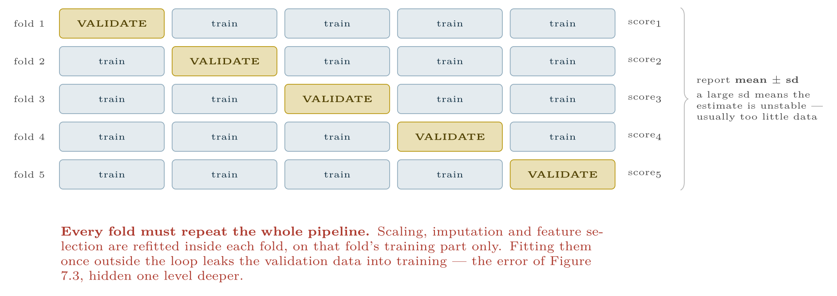
Five-fold cross-validation
FIGURE 14.3
Every observation is used for validation exactly once, so the performance estimate uses all the data and comes with a measure of its own stability.
Data Science · Chapter 14 · Model Evaluation and Selection
§14.5 · Handout p. 91 22
Notes:
Figure 14.3 (handout p. 91): Five-fold cross-validation. Every observation is used for validation exactly once, so the performance estimate uses all the data and comes with a measure of its own stability.

Slide 23

Cross-Validation
AT A GLANCE
Variant | What it does | Use when
k-fold (k=5 or 10) | Standard random folds | The default for independent rows
Stratified k-fold | Preserves class proportions in every fold | Always, for classification — especially imbalanced
Group k-fold | Keeps all rows of an entity in one fold | Multiple rows per student, device or user
Time-series split | Trains on the past, validates on the future | Any temporal data (Chapter 19)
Leave-one-out | k = n | Very small datasets; expensive and high-variance
Data Science · Chapter 14 · Model Evaluation and Selection
§14.5 · Handout p. 91 23
Notes:
Do not read the table row by row: pick the row the room is most likely to get wrong and ask why.

Slide 24

Common pitfalls
COMMON PITFALLS
✕
Reporting accuracy on imbalanced data. Always compare to the majority baseline first.
✕
Quoting a metric without its threshold. “Precision 0.9” is meaningless alone.
✕
Using ROC-AUC for rare positives. Use PR-AUC.
✕
Random cross-validation on time series or grouped rows. Use TimeSeriesSplit or GroupKFold.
✕
Tuning against the test set. That is what the validation folds are for; the test set is used once (Chapter 11).
Data Science · Chapter 14 · Model Evaluation and Selection
§14.5 · Handout p. 91 24
Notes:
For each pitfall, ask who has seen it happen. One real story beats five bullets.

Slide 25





Four lenses: Choosing a Metric
FOUR LENSES
LEARNING ANALYTICS
PROJECT MANAGEMENT
Optimise recall at a fixed staffing budget.
Use F₁ or balanced accuracy: over- and under-forecasting a sprint carry roughly comparable costs, so neither error dominates.
INTERNET OF THINGS
CYBERSECURITY
Optimise recall, then constrain precision by maintenance capacity.
Use the PR curve and report precision at fixed recall, e.g. “precision 0.42 at 80% recall”.
Data Science · Chapter 14 · Model Evaluation and Selection
Handout p. 94 25
Notes:
The same method, four domains. Each of the next four slides opens one lens in full.

Slide 26

Learning Analytics: Choosing a Metric
FOUR LENSES
LEARNING ANALYTICS
Project Management
Optimise recall at a fixed staffing budget. A missed at-risk student is far costlier than an unnecessary supportive phone call, as the worked example quantified. Report precision alongside it so staff know what proportion of calls will find someone who was fine — if that proportion is too embarrassing, the programme will quietly stop making the calls regardless of what your metric says.
Internet of Things
Cybersecurity
Data Science · Chapter 14 · Model Evaluation and Selection
Handout p. 94 26
Notes:
Learning Analytics. Optimise recall at a fixed staffing budget. A missed at-risk student is far costlier than an unnecessary supportive phone call, as the worked example quantified. Report precision alongside it so staff know what proportion of calls will find someone who was fine — if that proportion is too embarrassing, the programme will quietly stop making the calls regardless of what your metric says.

Slide 27

Project Management: Choosing a Metric
FOUR LENSES
PROJECT MANAGEMENT
Learning Analytics
Use F₁ or balanced accuracy: over- and under-forecasting a sprint carry roughly comparable costs, so neither error dominates. Beware tiny validation folds — with 40 sprints, 5-fold cross-validation validates on eight sprints at a time, so report the standard deviation across folds and expect it to be large.
Internet of Things
Cybersecurity
Data Science · Chapter 14 · Model Evaluation and Selection
Handout p. 94 27
Notes:
Project Management. Use F1 or balanced accuracy: over- and under-forecasting a sprint carry roughly comparable costs, so neither error dominates. Beware tiny validation folds — with 40 sprints, 5-fold cross-validation validates on eight sprints at a time, so report the standard deviation across folds and expect it to be large.

Slide 28

Internet of Things: Choosing a Metric
FOUR LENSES
INTERNET OF THINGS
Learning Analytics
Optimise recall, then constrain precision by maintenance capacity. A missed failure stops a line; an unnecessary inspection costs an hour. But note the second constraint: too many false alarms and technicians begin ignoring the system, which converts a precision problem into a recall problem in the real world. Use PR curves, since failures are rare.
Project Management
Cybersecurity
Data Science · Chapter 14 · Model Evaluation and Selection
Handout p. 94 28
Notes:
Internet of Things. Optimise recall, then constrain precision by maintenance capacity. A missed failure stops a line; an unnecessary inspection costs an hour. But note the second constraint: too many false alarms and technicians begin ignoring the system, which converts a precision problem into a recall problem in the real world. Use PR curves, since failures are rare.

Slide 29

Cybersecurity: Choosing a Metric
FOUR LENSES
CYBERSECURITY
Learning Analytics
Use the PR curve and report precision at fixed recall, e.g. “precision 0.42 at 80% recall”. ROC-AUC will look excellent and mean nothing, for the reason in the alert box above. Also track alerts per analyst per hour — a metric that appears in no textbook and decides whether the system is used. And set the threshold from the cost ratio, not from 0.5, because in this domain the two errors differ by orders of magnitude.
Project Management
Internet of Things
Data Science · Chapter 14 · Model Evaluation and Selection
Handout p. 94 29
Notes:
Cybersecurity. Use the PR curve and report precision at fixed recall, e.g. “precision 0.42 at 80% recall”. ROC-AUC will look excellent and mean nothing, for the reason in the alert box above. Also track alerts per analyst per hour — a metric that appears in no textbook and decides whether the system is used. And set the threshold from the cost ratio, not from 0.5, because in this domain the two errors differ by orders of magnitude.

Slide 30

Try it yourself: Evaluate Honestly
TRY IT YOURSELF
WHAT YOU WILL DO
1. Baseline first
2. The four cells
3. Threshold-free comparison; prefer PR-AUC when positives are rare
4. Choose the threshold from COSTS, not from 0.5
5. Cross-validate, stratified, whole pipeline inside the folds
THIS WEEK'S LAB
WHAT YOU WILL RUN
Week 8: Five classifiers; evaluate honestly
1 listing, 35 lines of Python
Data Science · Chapter 14 · Model Evaluation and Selection
§14.5 · Handout p. 91 30
Notes:
Say what the room will have at the end of the lab, then let them start. Circulate rather than lecture.

Slide 31
Evaluate Honestly
LAB · STEP 1 OF 6
Set-up
Python
1
2
3
4
5
import numpy as np
from sklearn.metrics import (confusion_matrix, classification_report,
roc_auc_score, average_precision_score,
precision_recall_curve)
from sklearn.model_selection import StratifiedKFold, cross_val_score
Data Science · Chapter 14 · Model Evaluation and Selection
§14.5 · Handout p. 91 31
Notes:
Step 1: Set-up. Read the code aloud; ask what each line would print before running it.

Slide 32
Evaluate Honestly
LAB · STEP 2 OF 6
Baseline first
Python
6
7
# --- 0. BASELINE FIRST -------------------------------------------------
print("majority-class accuracy:", max(np.mean(y_te), 1 - np.mean(y_te)))
Data Science · Chapter 14 · Model Evaluation and Selection
§14.5 · Handout p. 91 32
Notes:
Step 2: Baseline first. Read the code aloud; ask what each line would print before running it.

Slide 33
Evaluate Honestly
LAB · STEP 3 OF 6
The four cells
Python
8
9
10
11
12
13
# --- 1. the four cells -------------------------------------------------
proba = model.predict_proba(X_te)[:, 1]
pred = (proba > 0.5).astype(int)
tn, fp, fn, tp = confusion_matrix(y_te, pred).ravel()
print(f"TP={tp} FP={fp} FN={fn} TN={tn}")
print(classification_report(y_te, pred, digits=3))
Data Science · Chapter 14 · Model Evaluation and Selection
§14.5 · Handout p. 91 33
Notes:
Step 3: The four cells. Read the code aloud; ask what each line would print before running it.

Slide 34
Evaluate Honestly
LAB · STEP 4 OF 6
Threshold-free comparison; prefer PR-AUC when positives are rare
Python
14
15
16
# --- 2. threshold-free comparison; prefer PR-AUC when positives are rare
print("ROC-AUC:", roc_auc_score(y_te, proba))
print("PR-AUC :", average_precision_score(y_te, proba)) # <- the honest one
Data Science · Chapter 14 · Model Evaluation and Selection
§14.5 · Handout p. 91 34
Notes:
Step 4: Threshold-free comparison; prefer PR-AUC when positives are rare. Read the code aloud; ask what each line would print before running it.

Slide 35
Evaluate Honestly
LAB · STEP 5 OF 6
Choose the threshold from COSTS, not from 0.5
Python
17
18
19
20
21
22
23
24
25
26
# --- 3. choose the threshold from COSTS, not from 0.5 ------------------
COST_FP, COST_FN = 15, 4000
best_t, best_cost = 0.5, float("inf")
for t in np.linspace(0.01, 0.95, 95):
p = (proba > t).astype(int)
_, fp_, fn_, _ = confusion_matrix(y_te, p).ravel()
cost = COST_FP*fp_ + COST_FN*fn_
if cost < best_cost:
best_t, best_cost = t, cost
print(f"cost-optimal threshold {best_t:.2f} (cost ${best_cost:,.0f})")
Data Science · Chapter 14 · Model Evaluation and Selection
§14.5 · Handout p. 91 35
Notes:
Step 5: Choose the threshold from COSTS, not from 0.5. Read the code aloud; ask what each line would print before running it.

Slide 36
Evaluate Honestly
LAB · STEP 6 OF 6
Cross-validate, stratified, whole pipeline inside the folds
Python
27
28
29
30
# --- 4. cross-validate, stratified, whole pipeline inside the folds ----
cv = StratifiedKFold(5, shuffle=True, random_state=0)
s = cross_val_score(pipeline, X_tr, y_tr, cv=cv, scoring="average_precision")
print(f"CV PR-AUC {s.mean():.3f} +/- {s.std():.3f}")
Data Science · Chapter 14 · Model Evaluation and Selection
§14.5 · Handout p. 91 36
Notes:
Step 6: Cross-validate, stratified, whole pipeline inside the folds. Read the code aloud; ask what each line would print before running it.

Slide 37

A dataset is 97% negative. A model scores 96.5% accuracy. Is it any good?
CHECKPOINT 1 OF 3
Discuss with the person next to you, then advance.
Data Science · Chapter 14 · Model Evaluation and Selection
Handout p. 94 · answers in Appendix D 37
Notes:
Ask the room. Do not advance until someone commits to an answer.

Slide 38

A dataset is 97% negative. A model scores 96.5% accuracy. Is it any good?
CHECKPOINT 1 OF 3 · ANSWER
No — it is worse than useless. Predicting the majority class always would score 97%. The model is 0.5 points below doing nothing.
Data Science · Chapter 14 · Model Evaluation and Selection
Handout p. 94 · answers in Appendix D 38
Notes:
Answer (Appendix D): No — it is worse than useless. Predicting the majority class always would score 97%. The model is 0.5 points below doing nothing.

Slide 39
Of 500 flagged transactions, 60 were fraudulent; 20 frauds were missed. Compute precision and recall.
CHECKPOINT 2 OF 3
Discuss with the person next to you, then advance.
Data Science · Chapter 14 · Model Evaluation and Selection
Handout p. 94 · answers in Appendix D 39
Notes:
Ask the room. Do not advance until someone commits to an answer.

Slide 40
Of 500 flagged transactions, 60 were fraudulent; 20 frauds were missed. Compute precision and recall.
CHECKPOINT 2 OF 3 · ANSWER
Precision = 60/500 = 12%. Recall = 60/(60+20) = 60/80 = 75%.
Data Science · Chapter 14 · Model Evaluation and Selection
Handout p. 94 · answers in Appendix D 40
Notes:
Answer (Appendix D): Precision = 60/500 = 12%. Recall = 60/(60+20) = 60/80 = 75%.

Slide 41
You are told “AUC is 0.94” for a detector where 0.2% of events are attacks. What do you ask for instead, and why?
CHECKPOINT 3 OF 3
Discuss with the person next to you, then advance.
Data Science · Chapter 14 · Model Evaluation and Selection
Handout p. 94 · answers in Appendix D 41
Notes:
Ask the room. Do not advance until someone commits to an answer.

Slide 42
You are told “AUC is 0.94” for a detector where 0.2% of events are attacks. What do you ask for instead, and why?
CHECKPOINT 3 OF 3 · ANSWER
Ask for the precision–recall curve and for precision at a stated recall. With 0.2% positives, ROC-AUC is dominated by the enormous negative class and can look excellent while the alerts are mostly wrong.
Data Science · Chapter 14 · Model Evaluation and Selection
Handout p. 94 · answers in Appendix D 42
Notes:
Answer (Appendix D): Ask for the precision–recall curve and for precision at a stated recall. With 0.2% positives, ROC-AUC is dominated by the enormous negative class and can look excellent while the alerts are mostly wrong.

Slide 43

What to take away
CHAPTER SUMMARY
1
Every classification metric is a ratio of the four confusion-matrix cells.
2
Accuracy is dominated by the majority class; under imbalance it is actively misleading. Always compute the majority baseline first.
3
Precision answers “when I alarm, am I right?”; recall answers “of the real cases, how many did I catch?” They trade off against each other.
4
ROC-AUC is threshold-free but flatters rare-event detectors; prefer PR-AUC when positives are rare.
5
The 0.5 threshold is a default. Choose it by minimising expected cost, or by maximising recall subject to a capacity constraint.
6
Cross-validate with stratification, group by entity, respect time order, and refit the entire pipeline inside each fold.
Data Science · Chapter 14 · Model Evaluation and Selection
Handout p. 94 43
Notes:
Ask the room to say each takeaway before you reveal it.

Slide 44

Quick check 1 of 2
REVIEW · MULTIPLE CHOICE
Precision is:
A
TP/(TP+FN)
B
TP/(TP+FP)
C
(TP+TN)/all
D
TN/(TN+FP)
Data Science · Chapter 14 · Model Evaluation and Selection
Handout p. 94 44
Notes:
Take a show of hands for each option before discussing. (The handout does not print MCQ answers.)

Slide 45
Quick check 2 of 2
REVIEW · MULTIPLE CHOICE
When positives make up 0.5% of the data, the most informative curve is:
A
ROC
B
precision–recall
C
learning curve
D
residual plot
Data Science · Chapter 14 · Model Evaluation and Selection
Handout p. 94 45
Notes:
Take a show of hands for each option before discussing. (The handout does not print MCQ answers.)

Slide 46
For your notebook
REVIEW QUESTIONS
SHORT
Explain the accuracy paradox with a numeric example.
SHORT
Why must feature scaling be refitted inside every cross-validation fold?
SHORT
Give a scenario where you would deliberately accept a precision of 0.2, and justify it.
APPLIED
A model tested on 20,000 records with 400 positives flags 900 records, 300 of which are true positives. Build the full confusion matrix and compute accuracy, precision, recall, specificity and F₁. Then state which two numbers you would put in an executive summary and why.
APPLIED
For the same model, a false positive costs $8 and a false negative costs $1,200. Explain how you would find the optimal threshold, and predict whether it will be above or below 0.5, with reasoning.
Data Science · Chapter 14 · Model Evaluation and Selection
Handout p. 94 46
Notes:
Set these for independent study. Model answers are not printed in the handout.

Slide 47
End of Chapter 14
14
NEXT
READ
Chapter 15 — Feature Engineering and Ensembles
Handout Chapter 14, pages 88–94
THIS WEEK'S LAB
Five classifiers; evaluate honestly
Data Science · Chapter 14 · Model Evaluation and Selection
47
Notes:
Close. NEXT: Chapter 15 — Feature Engineering and Ensembles. READ: Handout Chapter 14, pages 88–94. THIS WEEK'S LAB: Five classifiers; evaluate honestly.

